Slide 1
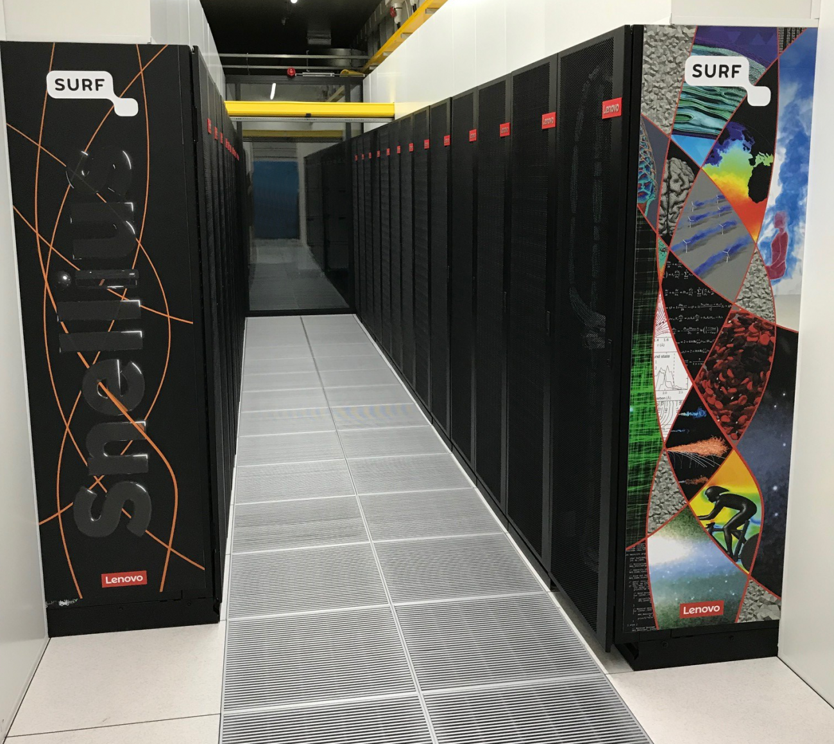

How to use Snellius
Hengjian Zhang
TU/e Supercomputing Center
12/12/2024

Slide 2
Agenda
Introduction to Snellius
Access to Snellius
Data transfer
Use of liabrary
Submit your jobs on Snellius
Further learning

Slide 3


Introduction to Snellius
Snellius is the Dutch National supercomputer hosted at SURF.
A detailed description of the system can be found in the SURF wiki.

Slide 4
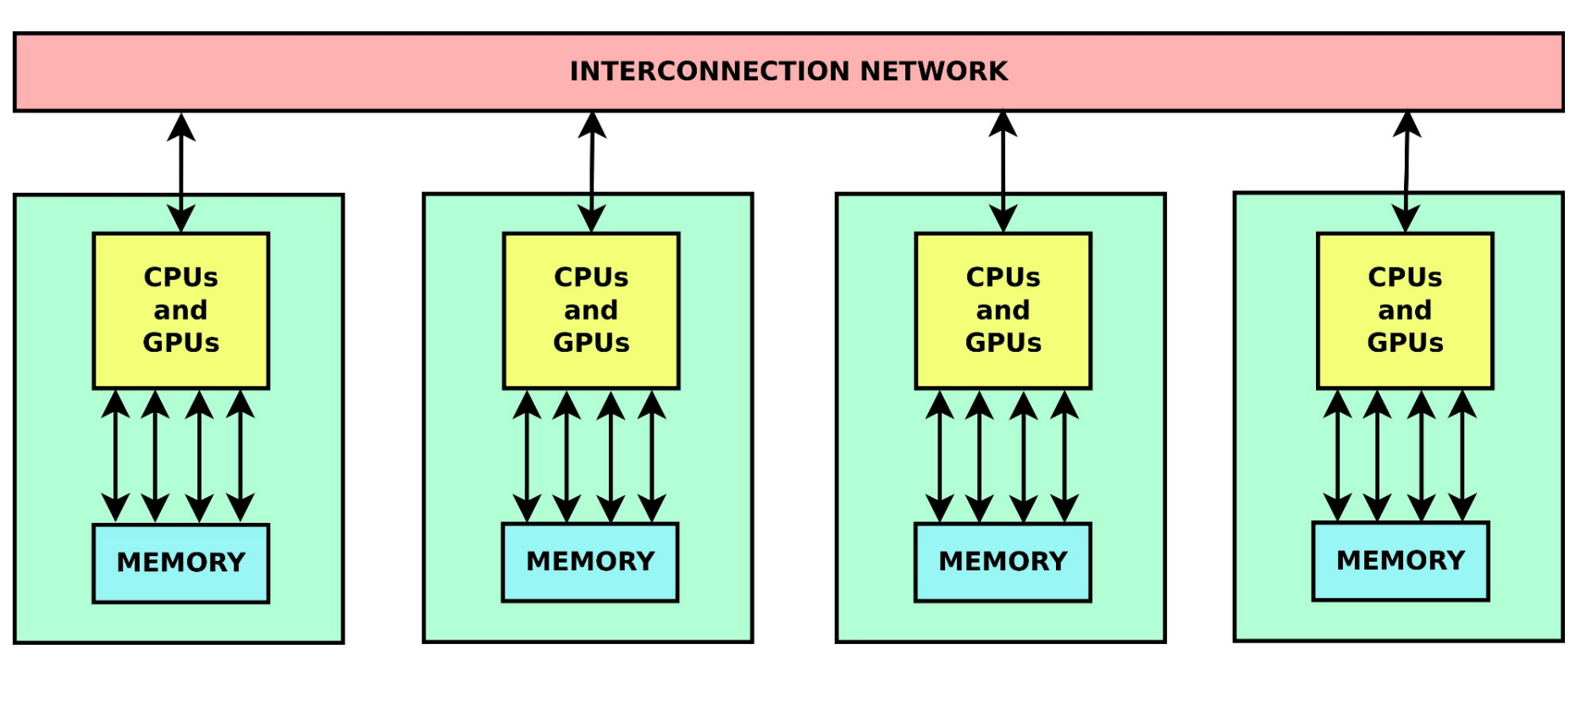
What is a supercomputer?
Credits: SURF team

Slide 5
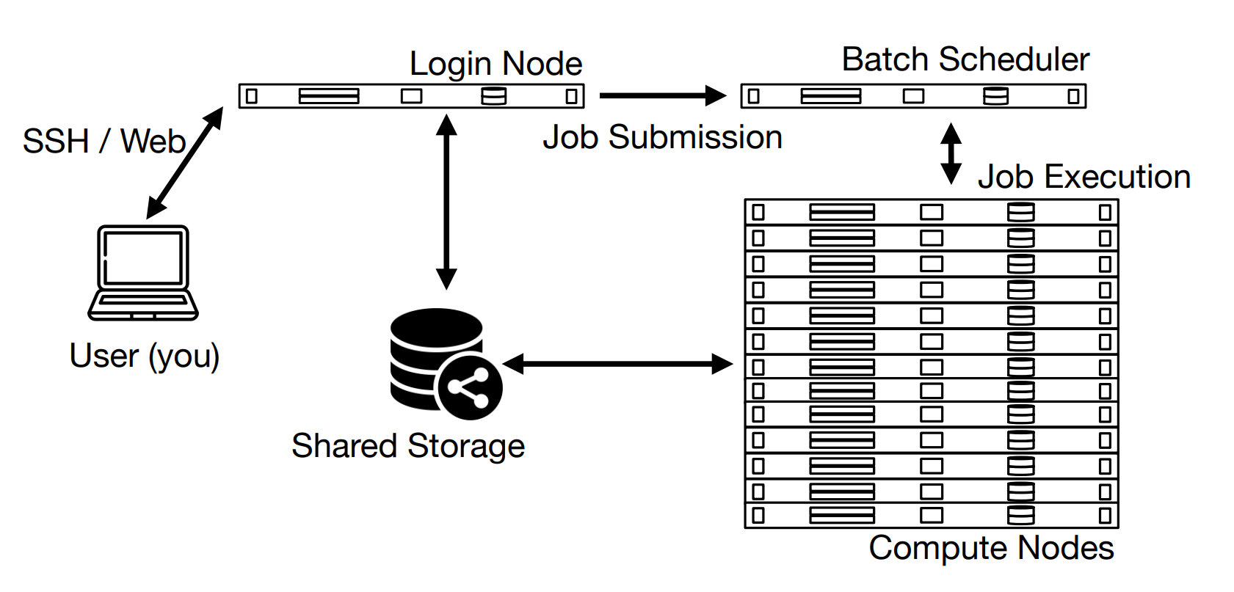

Using a supercomputer
Interacting with a cluster computer is different from a normal computer. Normal computers are mostly used interactively, i.e. you type a command or click with your mouse, and your computer instantly responds by e.g. running a program. Cluster computers are mostly used non-interactively.

Slide 6
Using a supercomputer
A cluster computer such as Snellius mainly has two types of nodes: login nodes and compute nodes.
login nodes: Entrance point. There are only a few login nodes on a cluster computer, and you only use them for light tasks, many users can be on the same login node at the same time.
Compute nodes: From the login node your job script is submitted to the job queue. As soon as sufficient resources (i.e. compute nodes) are available for your job, the system will take your job from the queue and send it to the compute nodes for execution.

Slide 7
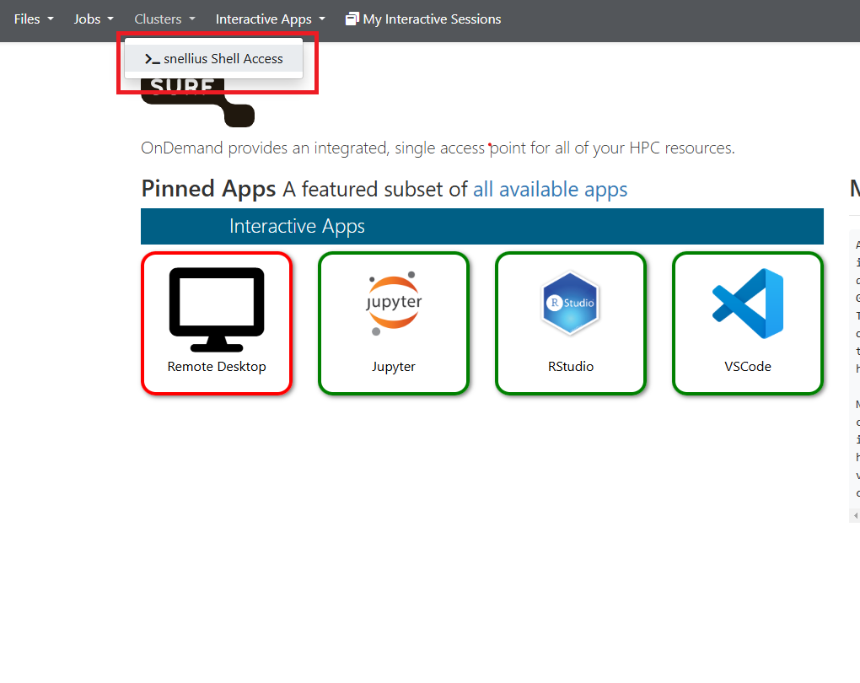
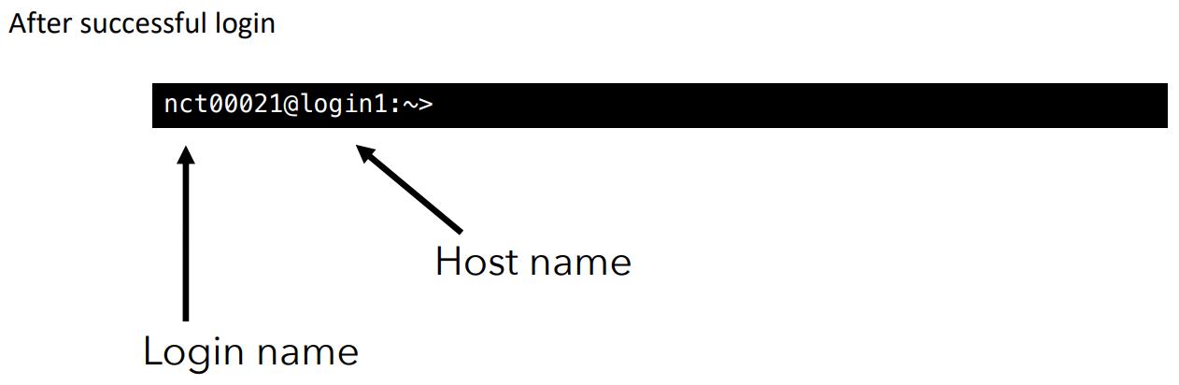
Access to Snellius login nodes
Connect to Snellius login nodes:
You can use either the web version from OnDemand
Or connect with terminal secure shell (SSH): ssh <username>@snellius.surf.nl

Slide 8
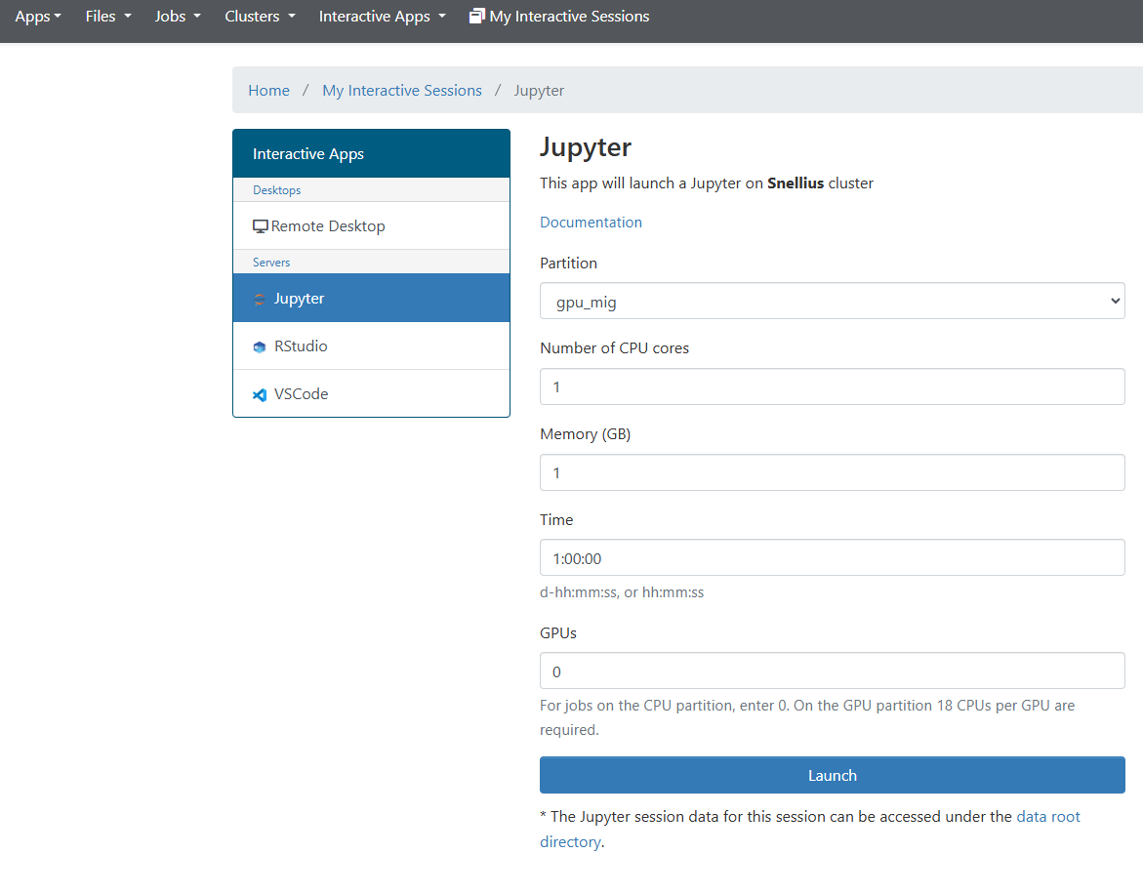
Access to Snellius compute nodes
Connect to Snellius compute nodes:
Schedule jobs (recommended, not burning your credits when not computing)
Interactive Apps (keep burning your credits even when not computing)
Jupyter
VS Code
Interactive access to compute node

Slide 9
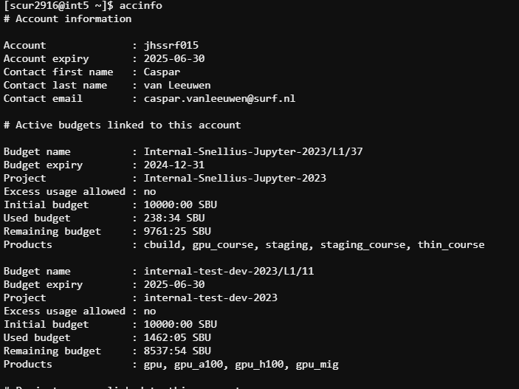
Login node
Check your remaining budgets: accinfo

Slide 10
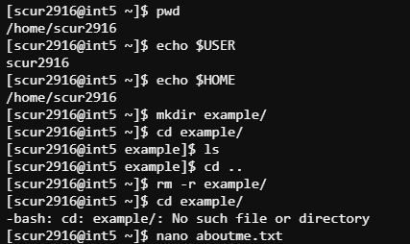
Login node - Exercise
Explore the file system: pwd, ls, cd
Create and edit files/directories: mkdir, cp, mv, nano, rm
Use env variables: $USER, $HOME

Slide 11
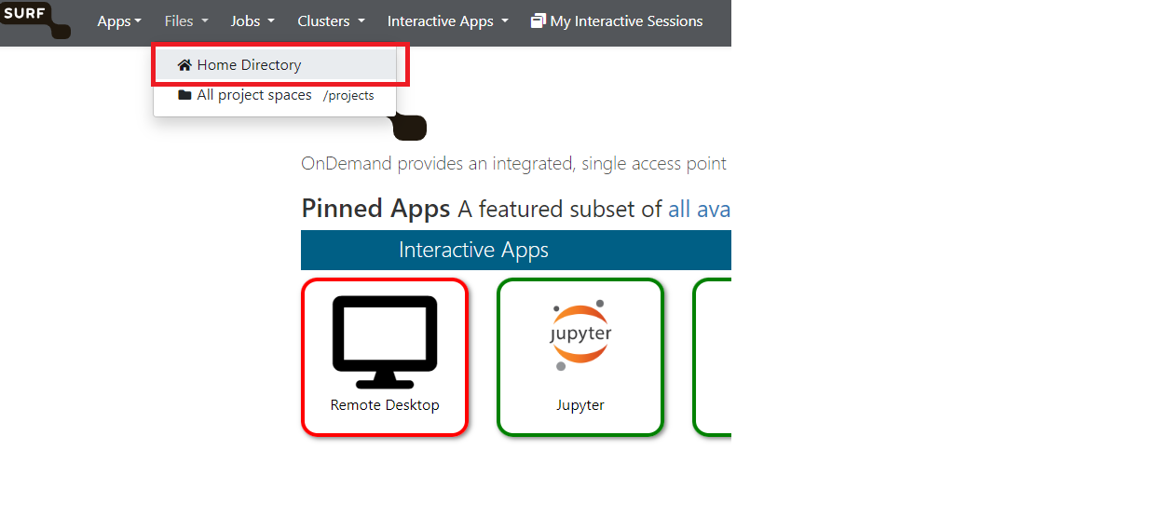
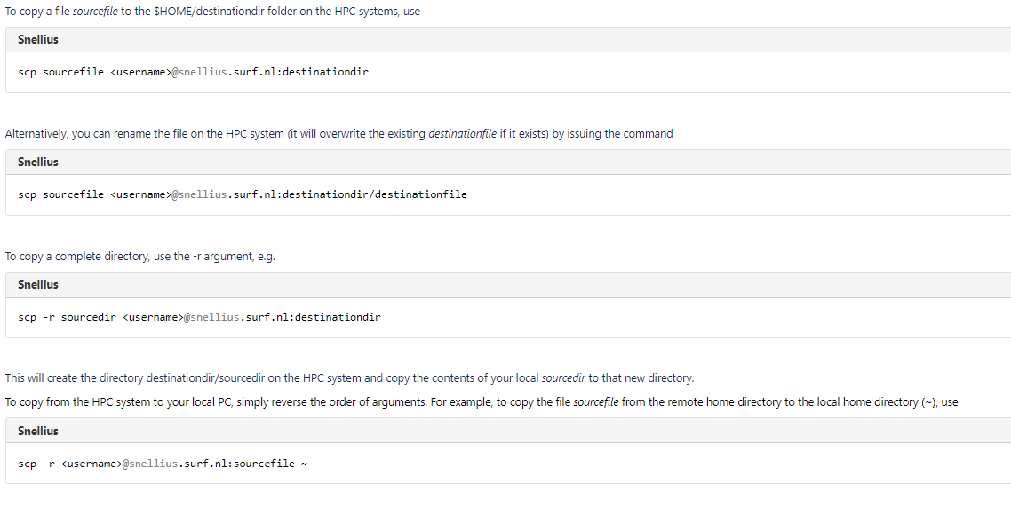
Data transfer
Transfer your data with ondemand Home Directory/git pull request/using the local terminal scp

Slide 12
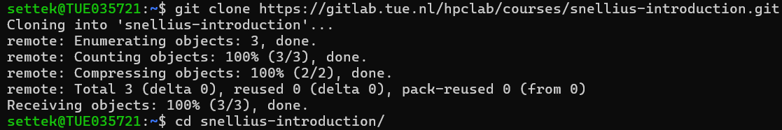
Data transfer - Exercise
Git clone the following repo:
git clone https://gitlab.tue.nl/hpclab/courses/snellius-introduction.git
Explore the git repository
cd snellius-introduction/
ls

Slide 13
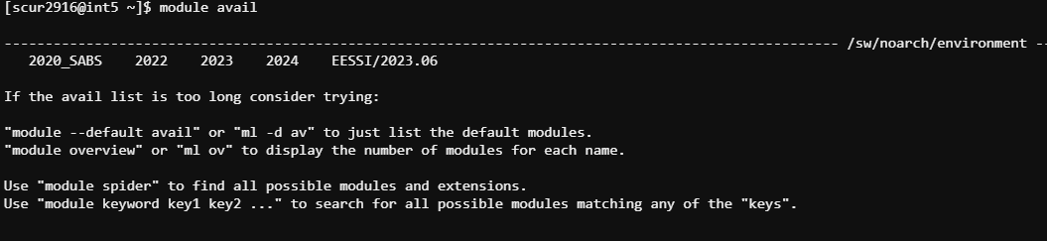
Use of library
Always check if the libraries you need is already available on HPC, because:
Optimized for the hardware of the supercomputer
Software is available as modules
A module automatically loads dependencies
Reduce waste of resources for the same library
Explore the file system: pwd, ls, cd
Use env variables: $USER, $HOME

Slide 14
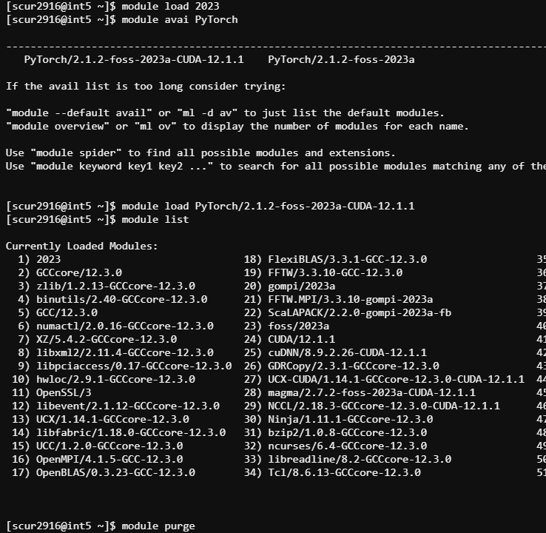
Use of library - exercise
Useful commands:
module avail - available modules in the system
module load <mod> - load <mod> in the shell environment
module list - show a list of all loaded modules
module unload <mod> - remove <mod> from the environment
module purge - unload all modules
module whatis <mod> - show information about <mod>

Slide 15
Use of library – what if the library is not available?
If the package you need is not included in existing modules, first create a virtual environment before pip install
python -m venv my_venv
source my_venv/bin/activate
pip install…

Slide 16
Submit your jobs on Snellius
Create a batch job script, for an example look example.sh (cat example.sh) in snellius-introduction.git
#!/bin/bash
#SBATCH --partition=gpu_mig
#SBATCH --gpus=1
#SBATCH --job-name=CheckEnvironment
#SBATCH --ntasks=1
#SBATCH --cpus-per-task=9
#SBATCH --time=00:05:00
#SBATCH --output=slurm_output_%A.txt
#SBATCH --error=slurm_error_%A.txt
# Load necessary modules (adjust based on your environment)
module purge
module load 2023
module load PyTorch/2.1.2-foss-2023a-CUDA-12.1.1
source my_venv/bin/activate # activate your virtual environment
# pip install --no-cache-dir -r requirements.txt
srun python -uc "import torch; print('GPU available?', torch.cuda.is_available())"

Slide 17
Submit your jobs on Snellius - exercise
Useful commands | Explained
sbatch <jobscript> | submit a job to the scheduler
squeue -j <job_id> | inspect the status of job <job_id>
squeue –u <user_id> | inspect all jobs of user <user_id>
scancel <job_id> | cancel job <job_id> before it runs
scontrol show job <job_id> | show estimated job start

Slide 18
Submit your jobs on Snellius – job arguments
Job arguments | Explained
#SBATCH --partition=gpu_mig | The partition of Snellius on which you want to run your job.
#SBATCH --gpus=1 | Number of GPUs you request from the nodes. If you haven’t designed your code to explicitly run on multiple GPUs, please use only one GPU
#SBATCH --job-name=CheckEnvironment | Name of the job to pop up when you list your jobs with squeue
#SBATCH --ntasks=1 | Number of tasks to run with the job.
#SBATCH --cpus-per-task=9 | Number of CPUs you request from the nodes. The gpu_mig partition restricts you to max. 9 CPUs per job/GPU.
#SBATCH --time=00:05:00 | Estimated time your job needs to finish. It is no problem if your job finishes earlier than the specified time. However, if your job takes longer, it will be instantaneously killed after the specified time. Still, don’t specify unnecessarily long times as this causes your job to be scheduled later (you need to wait longer in the queue if other people also want to use the cluster). A good rule of thumb is to specify ~20% more than what you would expect.
#SBATCH --output=slurm_output_%A.txt | Output file to which the slurm output should be written. The tag “%A” is automatically replaced by the job ID.
#SBATCH --error=slurm_error_%A.txt | Error file
Full list

Slide 19
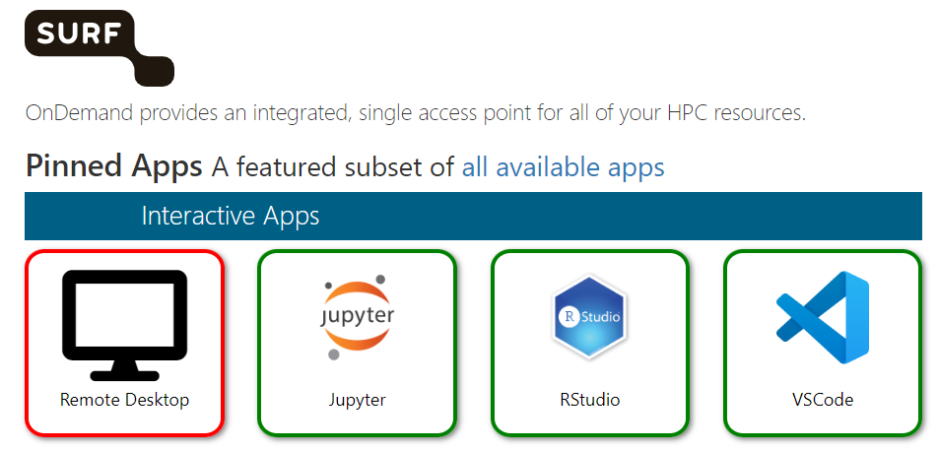
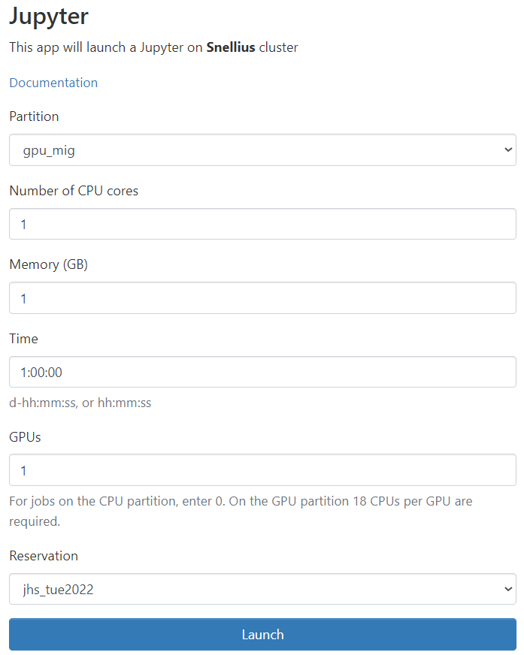
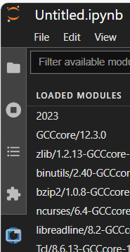

Use Jupyter notebooks
Go to Ondemand Snellius and login with your Snellius credentials
Go to Jupyter tile
Launch from GPU partition
CPU number and memory do not matter
GPU number does matter
You can use the reserved nodes for free (only gpu_mig) from reservation
Start or create notebook
TIPS:
You can (un)load modules by going to Jupyterlab -> Softwares (left menu bar)

Slide 20
Final exercise
Git clone https://gitlab.tue.nl/hpclab/courses/snellius-introduction.git
Have a look at the python script and the slurm job
cat gpu_pytorch_mnist.py
cat exercise.sh
Schedule job on reserved node
sbatch exercise.sh
Follow the status of the job
squeue
When the job is finished, check out the output file
cat %x_%j.out

Slide 21
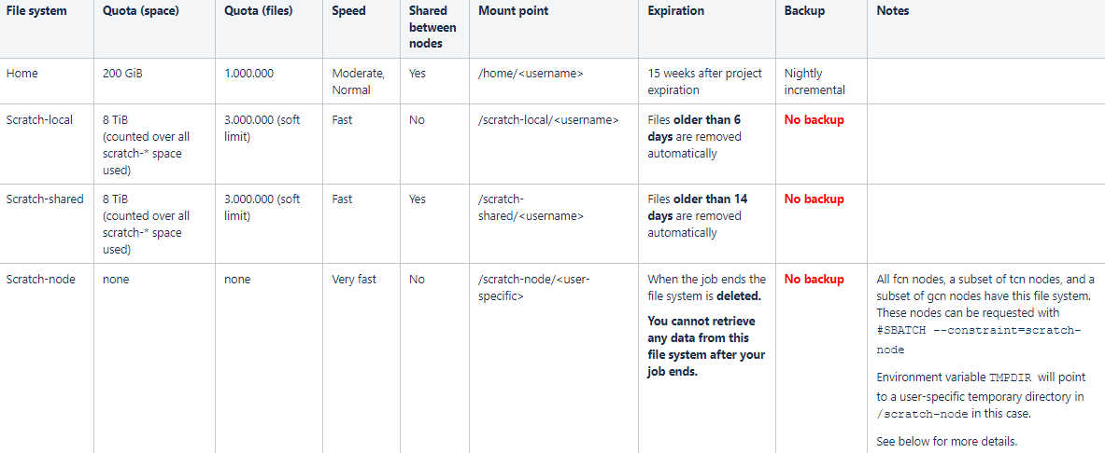
Further learning: speed up your training with scratch node
Expert advice: Run your job on $TMPDIR - When you store your datasets in your home directory, the read/write operation might become a bottleneck of your job. How to do it? link

Slide 22
Further learning: advices
Some models and datasets are already available on Snellius: link
Anaconda is not recommended on snellius: Beware: the anaconda is squeezing us
TU/e Supercomputing Center organizes a Spring and Autumn HPC School: HPC School Events
All my jobs are pending: link
More information about snellius please refer to SURF Wiki

Slide 23

Feel free to reach out
https://supercomputing.tue.nl/
Email: hpcsupport@tue.nl (we will help you!)

